Slide 1
Moral Conviction x Social Consensus Preliminary Report
Sean Duan

Slide 2
Support for Universal Health Care (UHC)

Slide 3
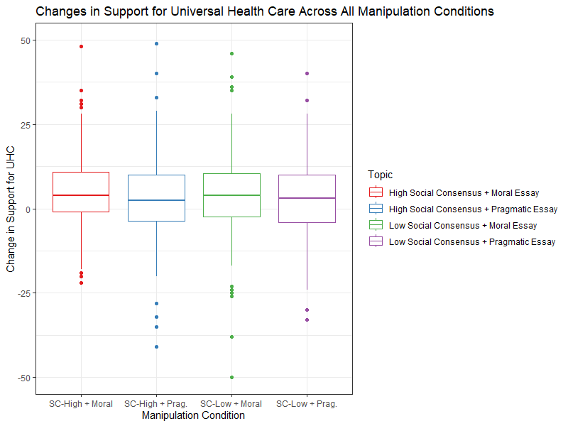

Slide 7
Support for Capital Punishment

Slide 8
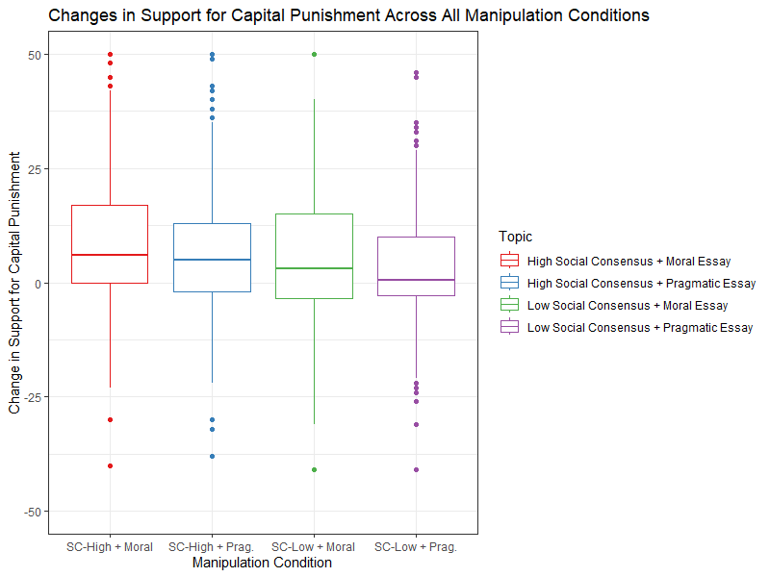

Slide 12
Support for Usage of AI in the Workplace

Slide 13
